Slide 1
Clay relief
Its types

Slide 2
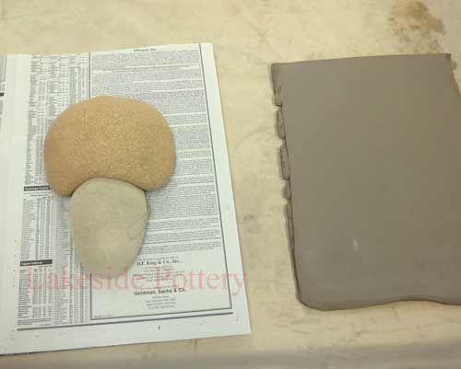
Prepare a slab

Slide 3
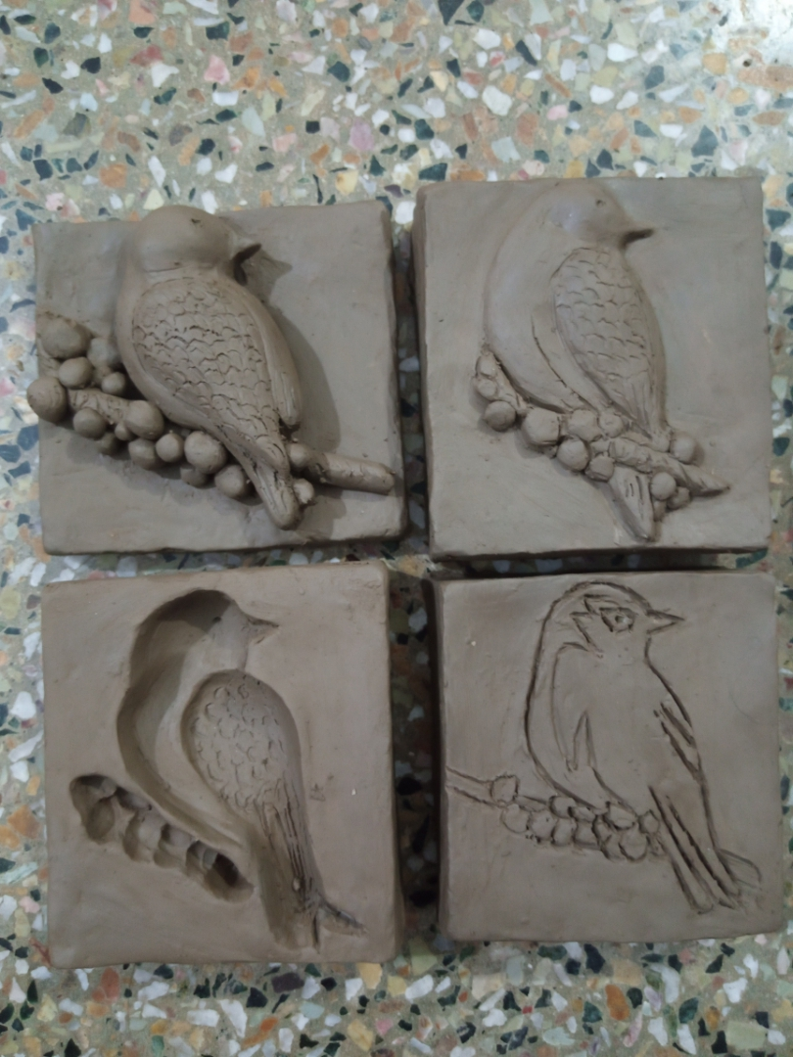
Engraving

Slide 4
Sunken or intaglio relief

Slide 5
Low relief

Slide 6
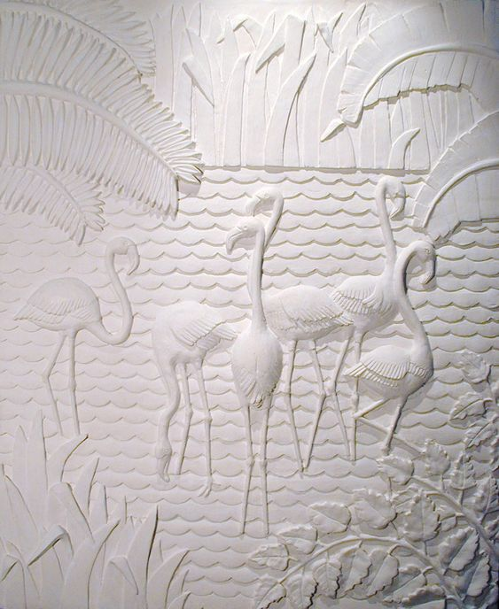
Low relief

Slide 7
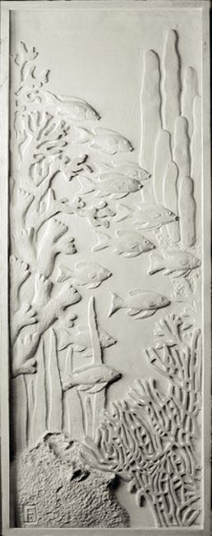

Slide 8

Bas relief

Slide 9
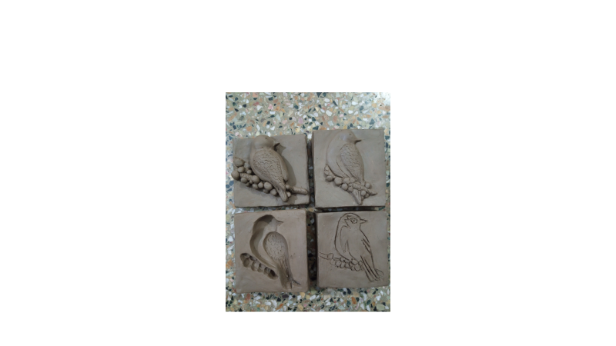

Slide 10
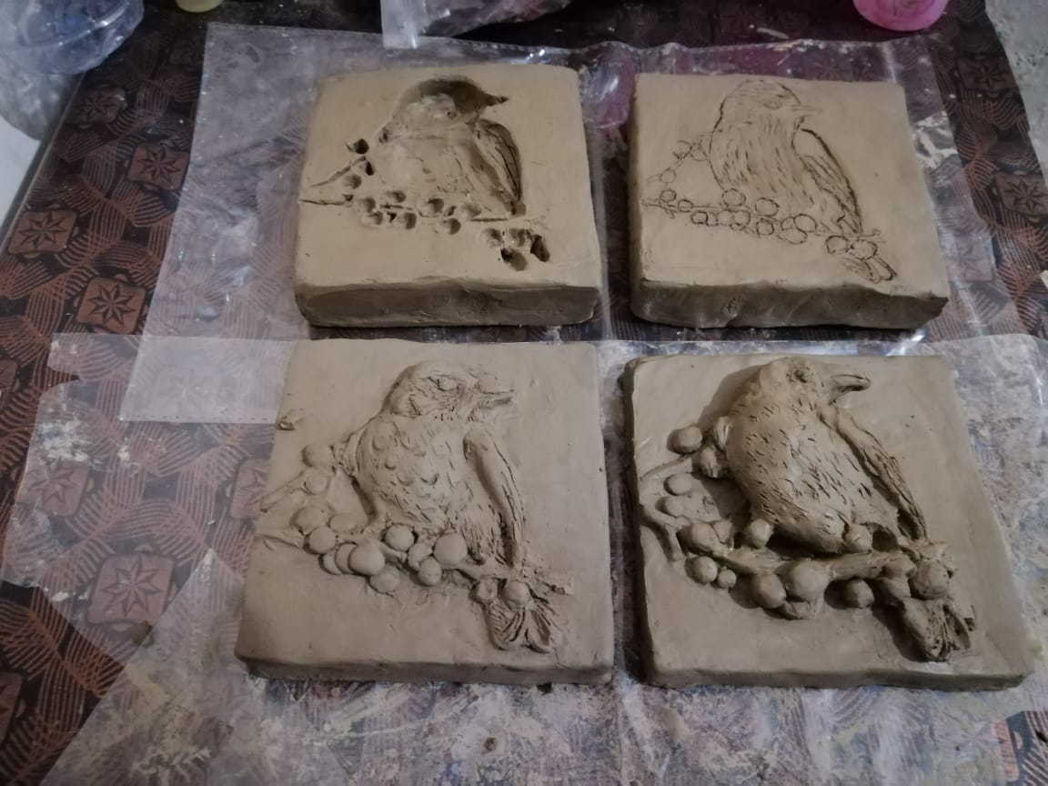

Slide 11
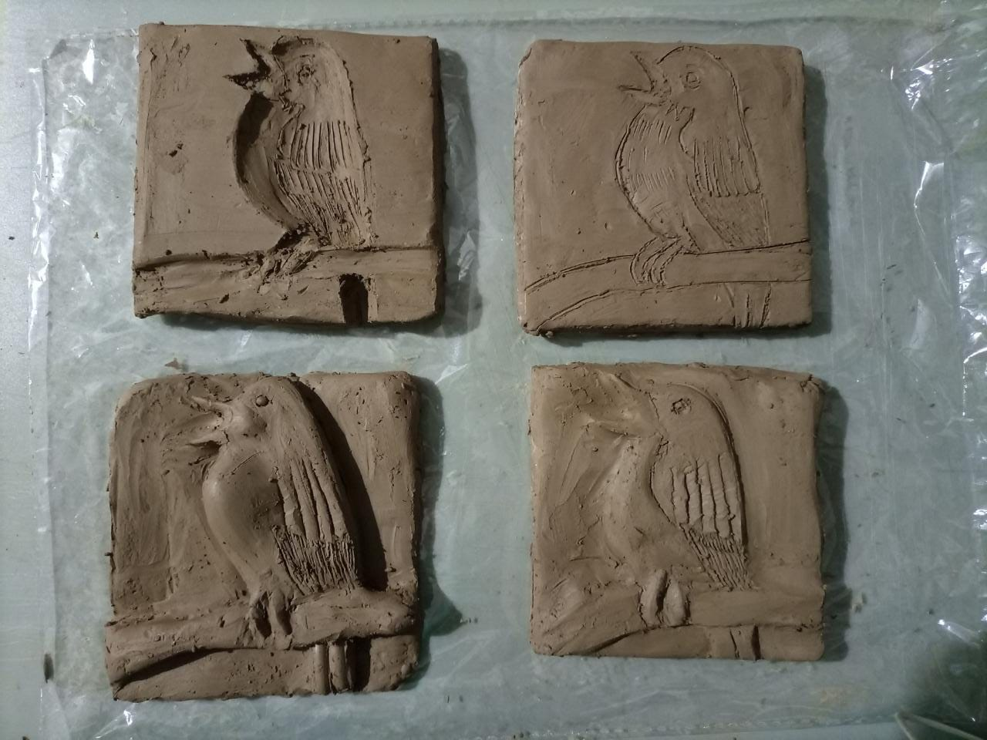

Slide 13
